Slide 1
Programming Fundamentals
Course Code: CS-111
Course Instructor: Isra Naz

Slide 2
Today’s Goals
Program Planning
Problem Solving
Problem solving techniques
  Algorithm
  Flowchart

Slide 3
Program Planning
To write a correct program, a programmer must write each and every instruction in the correct sequence.
i.e. it should be ensured that the instructions are
  Appropriate for the program
  In the correct sequence

Slide 4
Problem solving
Problem solving is the act of defining a problem; determining the cause of the problem; identifying, prioritizing, and selecting alternatives for a solution; and implementing a solution.

Slide 5
Problem solving techniques

Slide 6
Problem Solving Techniques
A typical programming task can be divided into two phases:
Problem solving phase
    produce an ordered sequence of steps that describe solution of problem
    this sequence of steps is called an algorithm
Implementation phase
    implement the program in some programming language

Slide 7
Steps in Problem Solving
First produce a general algorithm (one can use pseudocode)
Refine the algorithm successively to get step by step detailed Algorithm that is very close to a computer language.
Pseudocode is an artificial and informal language that helps programmers develop algorithms. Pseudocode is very similar to everyday English.

Slide 8
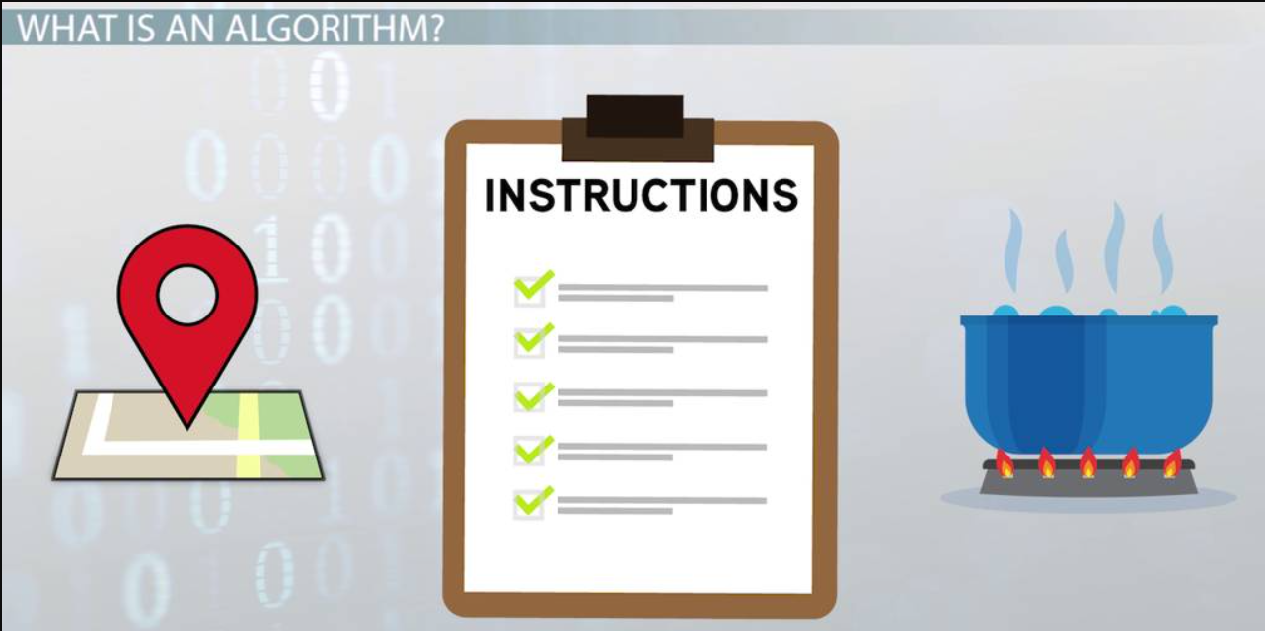

Slide 9
Algorithm
A computer algorithm is a detailed step by step method for solving the problem
An algorithm is a sequence of Clear-cut instructions for solving the problem in a finite amount of time.
More Generally an algorithm is any well defined computational procedure that takes collection of elements as input and produces collection of elements as output.

Slide 10
Algorithm
Also called the ‘program logic’ is a step-by-step description of how to arrive at solution of a given problem.
organized logical sequence of the actions
the approach towards a particular problem

Slide 11
Points to Note:
A precise sequence of a limited number of unambiguous, executable steps that terminates in the form of a solution.
3 Requirements:
Sequence is:
  Precise
  Consists of a limited number of steps
Each step is:
  Unambiguous
  Executable
The sequence of steps terminates in the form of a solution

Slide 12
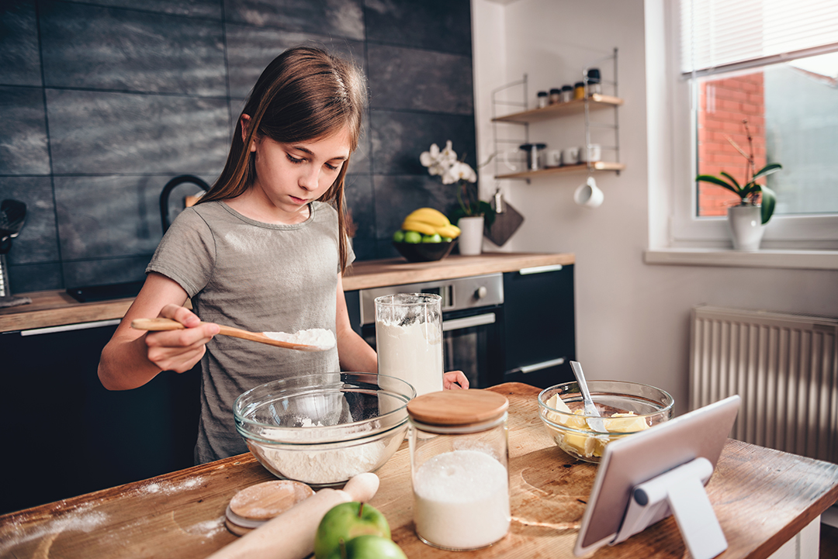
ALGORITHM IN REAL LIFE
Consider the following …
  Problem: Baking a Cake
  How to solve:
    Start
    Preheat the oven at 180ºC
    Gather the ingredients
    Prepare a baking pan
    Beat butter with sugar
    Mix them with flour, eggs and essence vanilla
    Pour the batter into the baking pan
    Put the pan into the oven
    Set timer
    When the timer goes off, take the pan out of oven.
    End

Slide 13
Example 1
Problem
  Print True if a number entered by user is less than 50.
Solution
Take input from user.
Initialize x. Store input value in x.
Check if x is less than 50.
Print True
Stop

Slide 14
Example 2:
Let us write down the algorithm for a problem that is familiar to us
Converting a decimal number into binary

Slide 15
Convert 75 to Binary
2
75
remainder
2
37
1
2
18
1
2
9
0
2
4
1
2
2
0
2
1
0
0
1
1001011

Slide 16
Algorithm for Decimal-to-Binary Conversion
Write the decimal number
Divide by 2; write quotient and remainder
Repeat step 2 on the quotient; keep on repeating until the quotient becomes zero
Write all remainder digits in the reverse order (last remainder first) to form the final result

Slide 17
Points to Note:
The process consists of repeated application of simple steps
All steps are unambiguous (clearly defined)
We are capable of doing all those steps
Only a limited no. of steps needs to be taken
Once all those steps are taken according to the prescribed sequence, the required result will be found
Moreover, the process will stop at that point

Slide 18
Example 3
Problem
  Write a simple algorithm to withdrawing money from an ATM.
Solution
Insert your card and enter your PIN.
Enter the withdrawal amount.
If your PIN is correct and funds are sufficient:
  Dispense cash.
  Offer a receipt (optional).
If your PIN is incorrect, try again (limited attempts).
Eject your card.

Slide 19
Representation of Algo.
As flowcharts
  Pictorial representation of an algorithm
As Pseudocode
  Is an imitation of actual computer instruction. i.e. it‘s written in English language, but looks like a program.
As Program
  Represented in the form of a programming language

Slide 20
The Flowchart
Flow chart is the graphical representation of an algorithm.
It is a way of visually representing the flow of data, the operations performed on data and the sequence in which the operations are performed on data.
Any error in the logic of the program can be detected very easily in flowchart.

Slide 21
The Flowchart
A Flowchart
  shows logic of an algorithm
  emphasizes individual steps and their interconnections
  e.g. control flow from one action to the next

Slide 22
The Flowchart
Advantages
Visual way to represent the information flow
Make our logic more clear
Efficient coding
Systematic debugging
Systematic testing

Slide 23
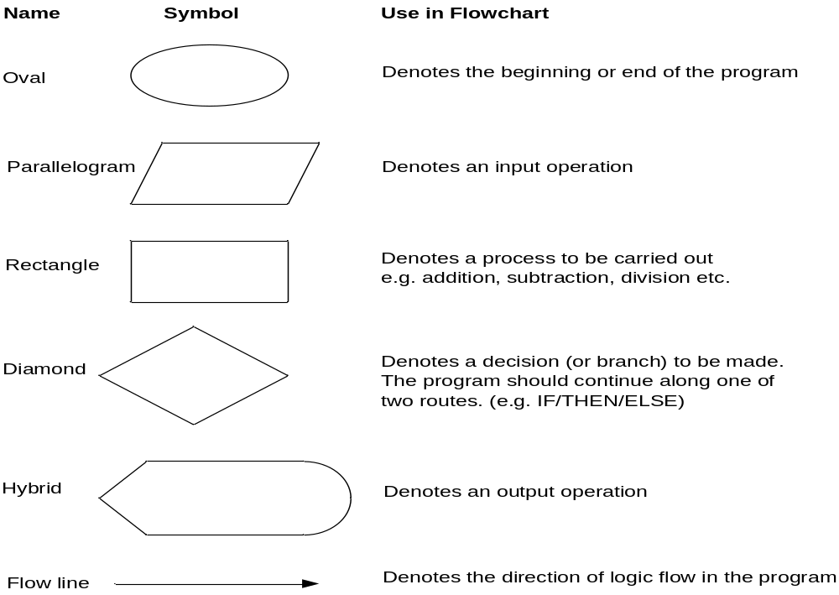
Flowchart Symbols

Slide 24
Flowchart
Terminal
  Start or stop
Processing
  Operations like add subtract etc.
Flow
  Flow / sequence of operation.
Connectors
  Required if the chart spreads over multiple pages
Terminal
Input / Output
Processing
Flow Lines
Decision
Connectors

Slide 25
Flowchart Guidelines
Chart the main logic, then incorporate detail.
Do not chart everything in the chart. A consistent level of detail to be maintained.
Names used should be problem specific.
Crossing of flow lines may be avoided.
Connectors may be leveled.
Construction should be left->right & top-
>bottom.

Slide 26
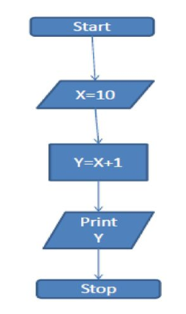
Flowchart Constructs
Sequence: The order of execution, this typically refers to the order in which the code will execute. Normally code executes line by line, so line 1 then 2 then 3 and so on.

Slide 27
FLOWCHART: EXAMPLE 1
Start
length, width and area are referred to as variables.
A variable is like a box in which a value can be stored
Input
length, width
area ← length X width
Output
area
End

Slide 28
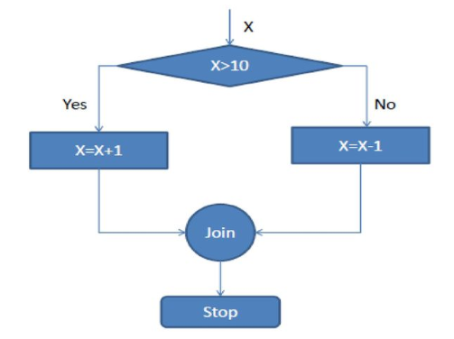
Flowchart Constructs
Selection:
Selection, like branching, is a method of controlling the execution sequence
We can create large control blocks, using if statements testing a condition, or switch statements evaluating a variable etc.
To control and change the execution of the program depending on this environment and changing variables.

Slide 29
FLOWCHART: EXAMPLE 2
Start
Selection
Input
height
false
true
height > 1.6?
Output
“You are short!”
Output
“You are tall!”
End

Slide 30
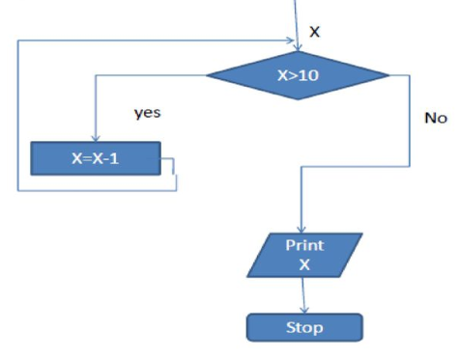
Flowchart Constructs
Iteration (Repetition)
Iteration is typically used to refer to collections and arrays of variables and data.
Repeating set of instruction.
Counting from 1 to 10, you are iterating over the first 10 numbers. for, while, do-while loops will be implemented for iteration.

Slide 31
Example
Find the % mark secured by a student, given all marks
Start
Read mark details
Add marks of all subjects giving total
Percentage = total / totalSubject
Print
percentage
Stop

Slide 32
Example 3
Write an algorithm and draw a flowchart to convert the length in feet to centimeter.
Algorithm
Read the length in feet (feet).
Multiply the length in feet by the conversion factor
length_in_cm = feet * 30.48
The result (length_in_cm) is the length in centimeters.
Flowchart
START
Input
Lft
Lcm = Lft x 30
WRITE
LCM
STOP

Slide 33
Example 4
Write an algorithm that reads two values, determines the largest value and prints the largest value with an identifying message.
ALGORITHM
Read the first value (value1).
Read the second value (value2).
If value1 is greater than value2:
  Set largest_value to value1.
  Display "The largest value is value1" with largest_value.
Else, if value2 is greater than or equal to value1:
  Set largest_value to value2.
  Display "The largest value is value2" with largest_value.
End.

Slide 34
Example 4
START
Input
VALUE1,VALUE2
Y
is
VALUE1>VALUE2
N
MAX ← VALUE1
MAX ← VALUE2
WRITE
MAX
STOP

Slide 35
Flowchart disadvantages
Very time consuming and laborious to draw.
Difficult to incorporate changes.
No standards available determining the amount of detail to be produced.

Slide 36
Questions?

